Slide 1


Slide 2
Remainder Theorem

Slide 3
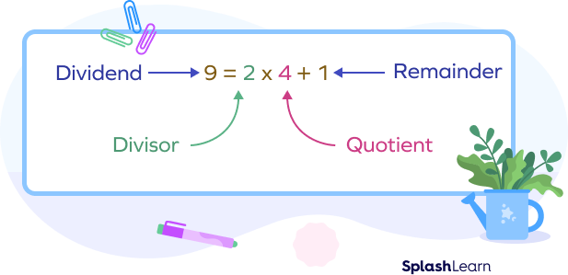
Introduction
Consider an example. The division 9÷2 can be written as:

Slide 4
Find the remainder (36*26*64*93)/7=?
ANSWER:
36/7=1 REMAINDER
26/7=2 REMAINDER
64/7=1 REMAINDER
93/7=2 REMAINDER
(1*2*1*2)/7=4/7=4 IS THE REMAINDER
NOTE: The remainder value should always be less than the divisor.

Slide 5

When 7³² is divided by 5, the remainder is?
ANSWER:
7³²/5=2³²/5
2³²/5=(2⁴)⁽⁸⁾/5=16⁸/5=1 is remainder.

Slide 6
When 9⁴⁵ is divided by 6, the remainder is?
ANSWER:
9⁴⁵/6=3⁴⁵/6
(3³)⁽¹⁵⁾/5=27¹⁵/5=2¹⁵/5
2¹⁵/5=[(2⁴)⁽³⁾*2³]/5=[(16)³*8]/5=1³*3/5=3 is remainder

Slide 7
If 4⁹⁶ is divided by 6, then how do you find the remainder?
ANSWER:
4 divided by 6, remainder 4
16 divided by 6, remainder 4
64 divided by 6, remainder 4
256 divided by 6, remainder 4
1024 divided by 6, remainder 4
From here we can see dividing any power of 4 results in the remainder 4.

Slide 8
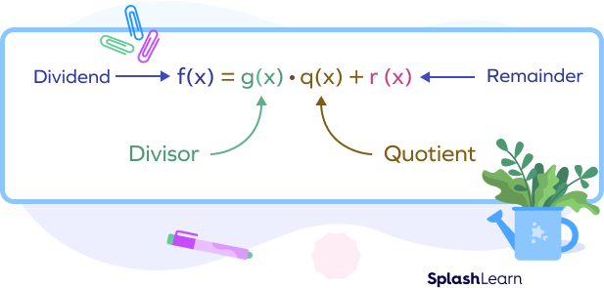
REMAINDER THEOREM: POLYNOMIALS
if we divide a polynomial f(x) by a linear polynomial g(x) and get a remainder as r(x), we can express it as:

Slide 9
Example: Find the remainder when p(x)=x²+4x+4 is divided by (x−1).
Method: Remainder theorem
Here, x−1=0⇒x=1
Thus, a=1
Remainder=p(1)=1²+4(1)+4=9
Here,Remainder =9

Slide 10
Practice:
When 2⁵¹² is divided by 5, the remainder is?
a)2
b)3
c)1
d)4

Slide 11
Note:
ANSWER:1
2⁵¹²/5=2⁴⁽¹²⁸⁾/5=16¹²⁸/5=1

Slide 12
When 19¹² is divided by 4, the remainder is?
a)1
b)2
c)0
d)none of these

Slide 13
Note:
ANSWER:1
19¹²/4=3¹²/4=(3³)⁴/4=27⁴/4=3⁴/4=(3²)²/4=9²/4=1

Slide 14
PRACTICE
Find the remainder when 12345678901234 is divided by 16.
a)5
b)6
c)2
d)4

Slide 15
Note:
ANSWER:2
DIVISIBILITY RULE OF 16 IS LAST 4 DIGITS MUST BE DIVISIBLE BY 16.
1234/16=2 REMAINDER

Slide 16
Practice
A number when divided by 259 leaves a remainder 139.What will be the remainder when the same number is divided by 37?
A)5
B)28
C)16
D)9

Slide 17
Note:
As 259 is perfectly divisible by 37. So, to get remainder when the number is divided by 37, you need to divide 139 by 37, you get quotient 3 and 28 remainder.
Thus, the answer is 28.

Slide 18
PRACTICE: When a number is divided by 35, it leaves a remainder of 18. What will be the remainder when the number is divided by 5?
A)3
B)5
C)7
D)17

Slide 19
Note:
Ans: The number 18 WHEN divided by 5, the remainder will be 3.

Slide 20
Practice
Find the remainder when p(x)=3x²+2x+5 is divided by (x+1).
A)5
B)6
C)7
D)8

Slide 21
Note:
X+1=0
X=-1
3x²+2x+5=3(-1)²+2(-1)+5=3-2+5=6 remainder

Slide 22
Practice
Find the remainder when p(x)=5x²+x+1 is divided by (2x-1).
a)2/5
b)8/3
c)11/4
d)9/2

Slide 23
Note
2x-1=0
x=1/2
5x²+x+1=5(1/2)²+1/2+1=5/4+1/2+1=11/4 as remainder

Slide 24
PRACTICE Using the Remainder Theorem, find the remainder when x⁶ – 5x⁴ + 3x² + 10 is divided by x – 2.
a)1
b)5
c)9
d)6

Slide 25
Note:
Substitute x = 2
= (2)⁶ – 5(2)⁴ + 3(2)² + 10
= 64 – 80 + 12 + 10
= 86 – 80
= 6

Slide 26
Thank You

